Slide 1

空氣監測站 Air Monitoring System
參賽編號： S23
La Salle College
Version 3.2

Slide 2
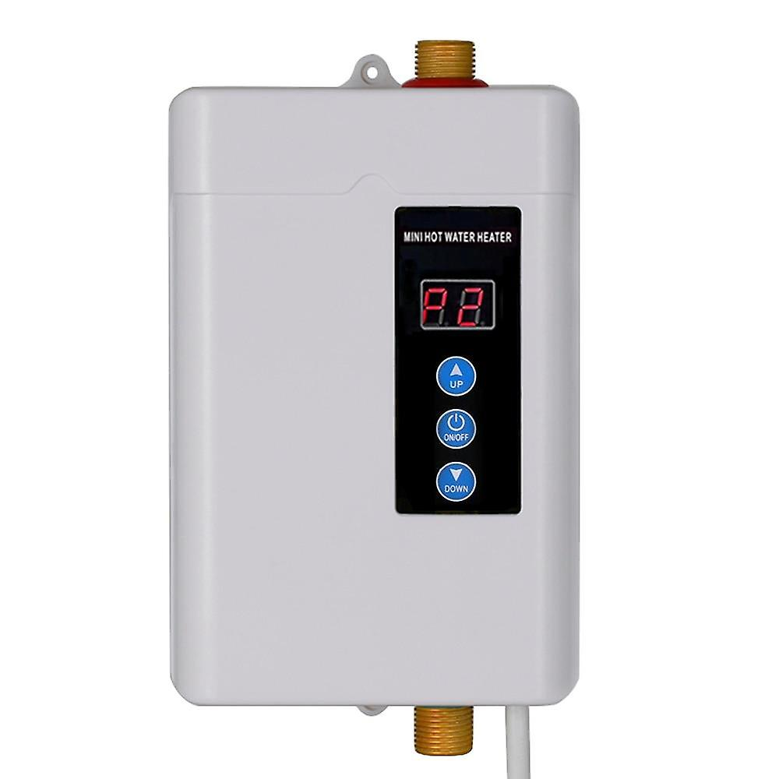

長者 elderly
樂齡科技 ↔ 與長者有關
Related to elderly
安全意識
Safety Consciousness
例子：熱水澡
Example: A hot water bath

Slide 3
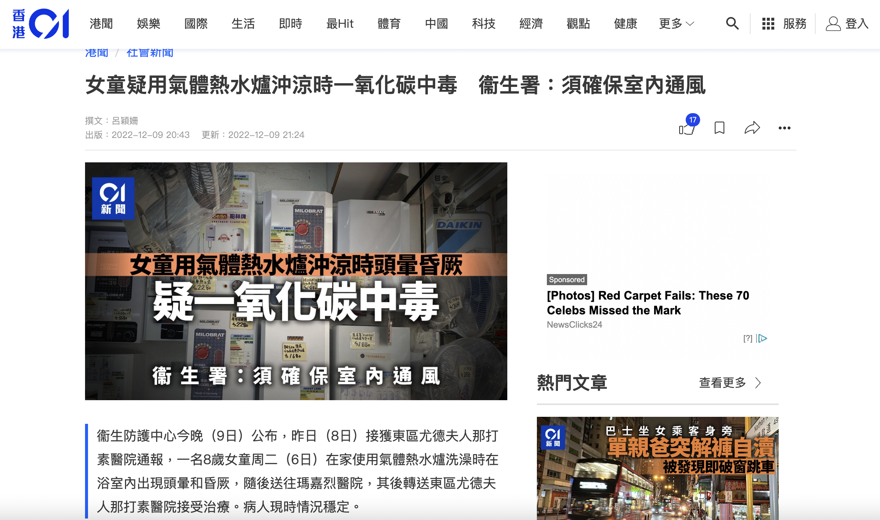

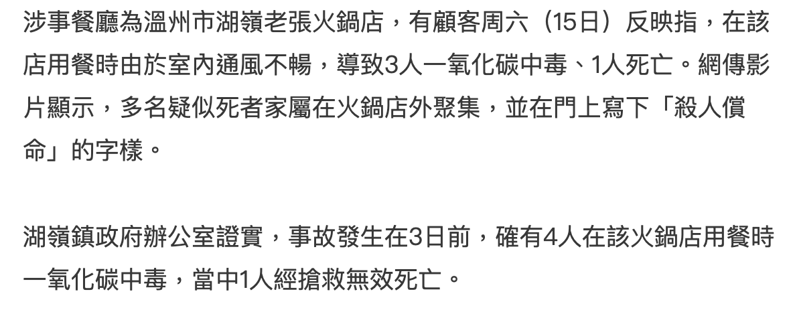
目的 Purpose of our product
每年，至少430人在美國因意外一氧化碳中毒
致死
Every year, at least 430 people die in the U.S. from accidental carbon monoxide poisoning.
Source: Centre for Disease Control and Prevention, US

Slide 4
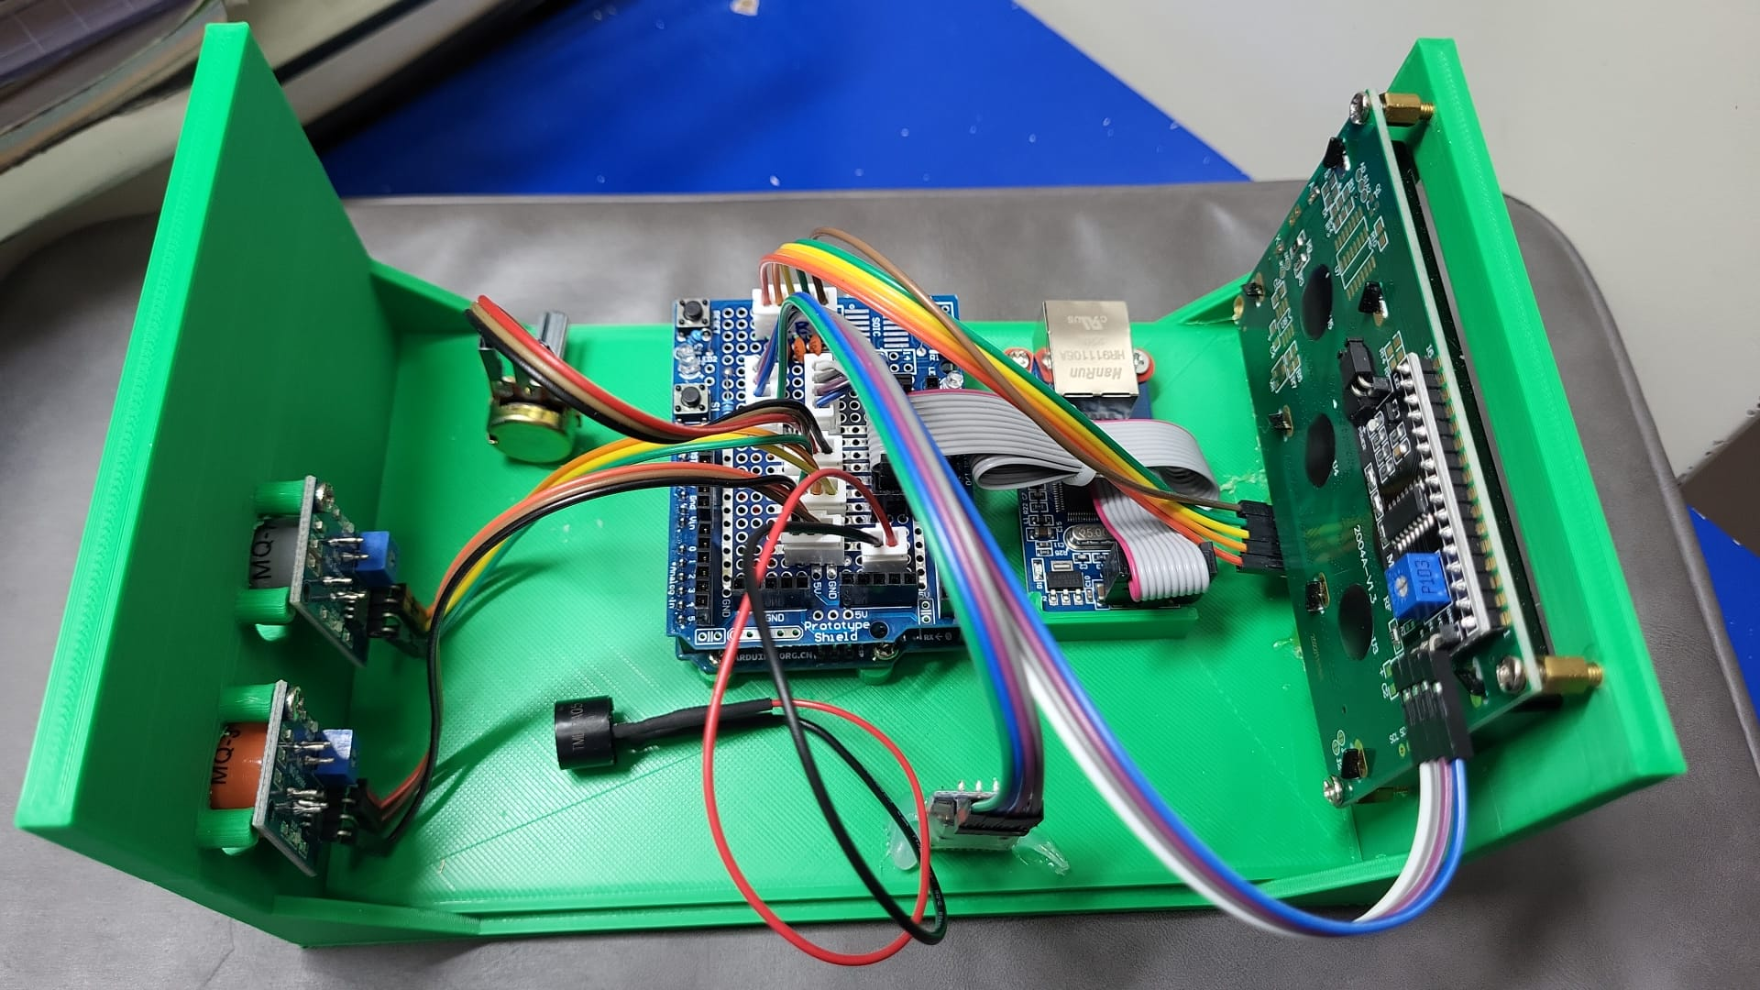

Slide 5
2004A 液晶顯示器
2004A LCD
display
W5100/W5500乙太網
擴展版/模塊
W5100/
W5500
Ethernet shield/
module
MQ 系列
探測器
（圖中為 MQ-3
和MQ-7，
可更換）
MQ-series
sensors
(MQ-3 and
MQ-7 in
this diagram,
can change
up to needs)
Arduino Uno
HC-06 藍芽模組
HC-06 Bluetooth module
蜂鳴器
Buzzer

Slide 6
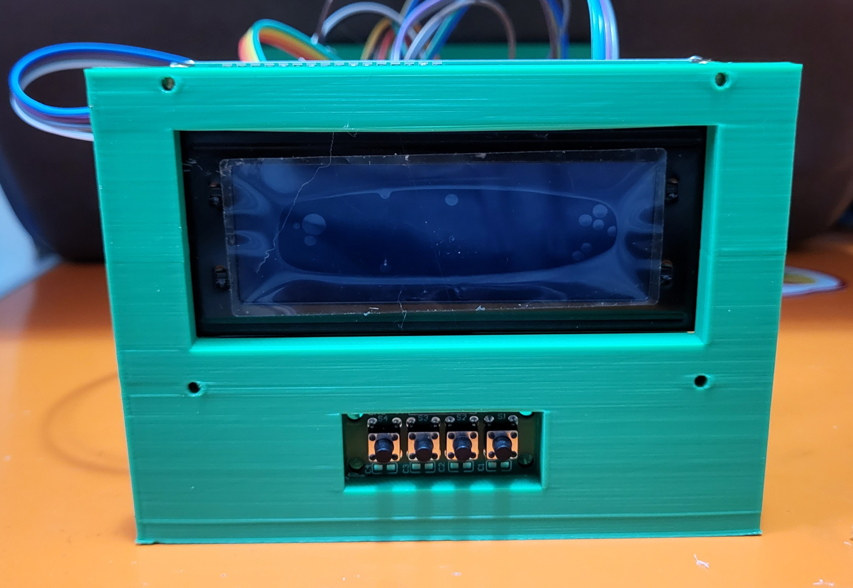
重啟系統
Rebooting the system
允許/禁止用網絡傳送讀數
Enable/Disable sending data
to the IP address
在顯示器上顯示探測器讀數
To show the sensor readings
允許/禁止用藍芽傳送讀數
Enable/Disable sending data
to smart phone using Bluetooth

Slide 7
Flexible
Affordable
Migratable
Extensible
好處
Advantage of
our device

Slide 8
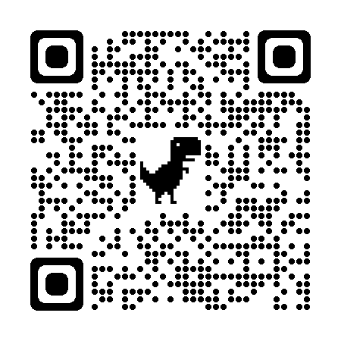

If you want to know how the system works, please visit:
https://drive.google.com/file/d/1oYti4GL02FGXTXtIRkP-JbMugn9ZTjfW/view?usp=sharing
For details of how the gas sensor works, please visit:
MQ-3 sensor : https://lastminuteengineers.com/mq3-alcohol-sensor-arduino-tutorial/
MQ-7 sensor : https://www.circuits-diy.com/mq7-carbon-monoxide-co-gas-sensor-module/
Notes: You may use other MQ series sensors with this system

